Slide 1

Making Method Calls Simpler
Objects are all about interfaces. Coming up with interfaces that are easy to understand, and use is a key skill in developing good object-oriented software. This chapter explores refactoring that make interfaces more straightforward.

Slide 2
Often the simplest and most important thing you can do is to change the name of a method. Naming is a key tool in communication. If you understand what a program is doing, you should not be afraid to use Rename Method to pass on that knowledge. You can (and should) also rename variables and classes. Overall, these renaming's are fairly simple text replacements, so I haven't added extra refactoring's for them.

Slide 3
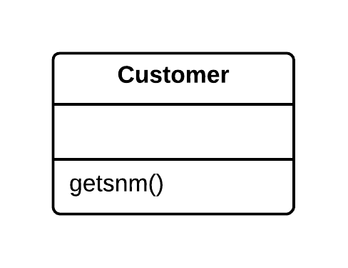
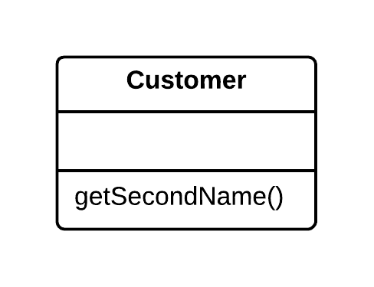
Rename Method
Problem | Solution
The name of a method does not explain what the method does. | Rename the method.

Slide 4
Rename Method
Why Refactor
Perhaps a method was poorly named from the very beginning – for example, someone created the method in a rush and did not give proper care to naming it well.
Or perhaps the method was well named at first but as its functionality grew, the method name stopped being a good descriptor.

Slide 5
Rename Method
Benefits
Code readability. Try to give the new method a name that reflects what it does.
Something like createOrder(), renderCustomerInfo(), etc.

Slide 6
Rename Method
How to Refactor
See whether the method is defined in a superclass or subclass. If so, you must repeat all steps in these classes too.
The next method is important for maintaining the functionality of the program during the refactoring process. Create a new method with a new name. Copy the code of the old method to it. Delete all the code in the old method and, instead of it, insert a call for the new method.
Find all references to the old method and replace them with references to the new one.
Delete the old method. If the old method is part of a public interface, do not perform this step. Instead, mark the old method as deprecated.

Slide 7
Parameters themselves have quite a role to play with interfaces. Add Parameter and Remove Parameter are common refactoring's

Slide 8
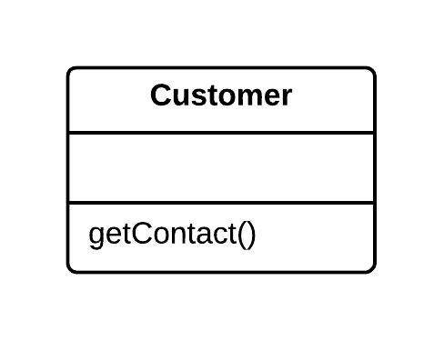
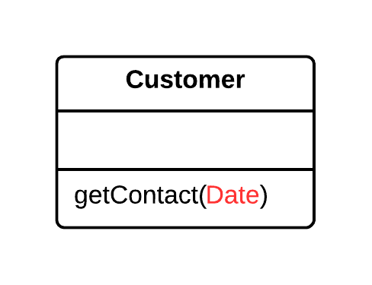
Add Parameter
Problem | Solution
A method does not have enough data to perform certain actions. | Create a new parameter to pass the necessary data.

Slide 9
Add Parameter
Why Refactor
You need to make changes to a method and these changes require adding information or data that was previously not available to the method.
Benefits
The choice here is between adding a new parameter and adding a new private field that contains the data needed by the method. A field is preferable when you need some occasional or frequently changing data for which there is no point in holding it in an object all of the time. In this case, a new parameter will be a better fit than a private field and the refactoring will pay off. Otherwise, add a private field and fill it with the necessary data before calling the method.

Slide 10
Add Parameter
Drawbacks
Adding a new parameter is always easier than removing it, which is why parameter lists frequently balloon to grotesque sizes. This smell is known as the Long Parameter List.
If you need to add a new parameter, sometimes this means that your class does not contain the necessary data, or the existing parameters do not contain the necessary related data. In both cases, the best solution is to consider moving data to the main class or to other classes whose objects are already accessible from inside the method.

Slide 11
Add Parameter
How to Refactor
See whether the method is defined in a superclass or subclass. If the method is present in them, you will need to repeat all the steps in these classes as well.
The following step is critical for keeping your program functional during the refactoring process. Create a new method by copying the old one and add the necessary parameter to it. Replace the code for the old method with a call to the new method. You can plug in any value to the new parameter (such as null for objects or a zero for numbers).
Find all references to the old method and replace them with references to the new method.
Delete the old method. Deletion is not possible if the old method is part of the public interface. If that is the case, mark the old method as deprecated.

Slide 12
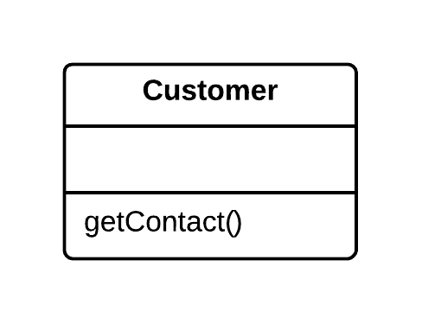
Remove Parameter
Problem | Solution
A parameter is not used in the body of a method. | Remove the unused parameter.

Slide 13
Remove Parameter
Why Refactor
Every parameter in a method call forces the programmer reading it to figure out what information is found in this parameter. And if a parameter is entirely unused in the method body, this “noggin scratching” is for naught.
And in any case, additional parameters are extra code that has to be run.
Sometimes we add parameters with an eye to the future, anticipating changes to the method for which the parameter might be needed. All the same, experience shows that it is better to add a parameter only when it is genuinely needed. After all, anticipated changes often remain just that – anticipated.

Slide 14
Remove Parameter
Benefits
A method contains only the parameters that it truly requires.
When Not to Use
If the method is implemented in different ways in subclasses or in a superclass, and your parameter is used in those implementations, leave the parameter as-is.

Slide 15
Remove Parameter
How to Refactor
See whether the method is defined in a superclass or subclass. If so, is the parameter used there? If the parameter is used in one of these implementations, hold off on this refactoring technique.
The next step is important for keeping the program functional during the refactoring process. Create a new method by copying the old one and delete the relevant parameter from it. Replace the code of the old method with a call to the new one.
Find all references to the old method and replace them with references to the new method.
Delete the old method. Do not perform this step if the old method is part of a public interface. In this case, mark the old method as deprecated.

Slide 16
Programmers new to objects often use long parameter lists, which are typical of other development environments. Objects allow you to keep parameter lists short, and several more involved refactoring's give you ways to shorten them. If you are passing several values from an object, use Preserve Whole Object to reduce all the values to a single object. If this object does not exist, you can create it with Introduce Parameter Object. If you can get the data from an object to which the method already has access, you can eliminate parameters with Replace Parameter with Method. If you have parameters that are used to determine conditional behavior, you can use Replace Parameter with Explicit Methods. You can combine several similar methods by adding a parameter with Parameterize Method.

Slide 17
Preserve Whole Object
Problem | Solution
You get several values from an object and then pass them as parameters to a method. | Instead, try passing the whole object.
int low = daysTempRange.getLow();
int high = daysTempRange.getHigh();
boolean withinPlan = plan.withinRange(low, high);
boolean withinPlan = plan.withinRange(daysTempRange);

Slide 18
Preserve Whole Object
Why Refactor
The problem is that each time before your method is called, the methods of the future parameter object must be called. If these methods or the quantity of data obtained for the method are changed, you will need to carefully find a dozen such places in the program and implement these changes in each of them.
After you apply this refactoring technique, the code for getting all necessary data will be stored in one place – the method itself.

Slide 19
Preserve Whole Object
Benefits
Instead of a hodgepodge of parameters, you see a single object with a comprehensible name.
If the method needs more data from an object, you will not need to rewrite all the places where the method is used – merely inside the method itself.
Drawbacks
Sometimes this transformation causes a method to become less flexible: previously the method could get data from many different sources but now, because of refactoring, we are limiting its use to only objects with a particular interface.

Slide 20
Preserve Whole Object
How to Refactor
Create a parameter in the method for the object from which you can get the necessary values.
Now start removing the old parameters from the method one by one, replacing them with calls to the relevant methods of the parameter object. Test the program after each replacement of a parameter.
Delete the getter code from the parameter object that had preceded the method call.

Slide 21
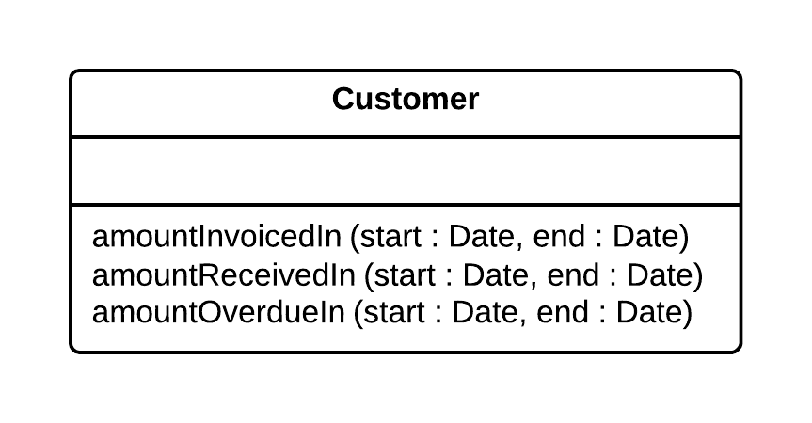
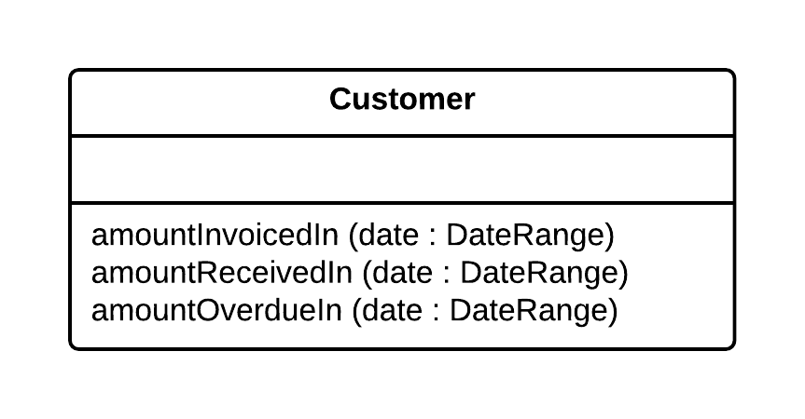
Introduce Parameter Object
Problem | Solution
Your methods contain a repeating group of parameters. | Replace these parameters with an object.

Slide 22
Introduce Parameter Object
Why Refactor
Identical groups of parameters are often encountered in multiple methods. This causes code duplication of both the parameters themselves and of related operations. By consolidating parameters in a single class, you can also move the methods for handling this data there as well, freeing the other methods from this code.

Slide 23
Introduce Parameter Object
Benefits
More readable code. Instead of a hodgepodge of parameters, you see a single object with a comprehensible name.
Identical groups of parameters scattered here and there create their own kind of code duplication: while identical code is not being called, identical groups of parameters and arguments are constantly encountered.
Drawbacks
If you move only data to a new class and do not plan to move any behaviors or related operations there, this begins to smell of a Data Class.

Slide 24
Introduce Parameter Object
How to Refactor
Create a new class that will represent your group of parameters. Make the class immutable.
In the method that you want to refactor, use Add Parameter, which is where your parameter object will be passed. In all method calls, pass the object created from old method parameters to this parameter.
Now start deleting old parameters from the method one by one, replacing them in the code with fields of the parameter object. Test the program after each parameter replacement.
When done, see whether there is any point in moving a part of the method (or sometimes even the whole method) to a parameter object class. If so, use Move Method or Extract Method.

Slide 25
Replace Parameter with Explicit Methods
Problem | Solution
A method is split into parts, each of which is run depending on the value of a parameter. | Extract the individual parts of the method into their own methods and call them instead of the original method.
void setValue(String name, int value) {
if (name.equals("height")) {
height = value;
return; }
if (name.equals("width")) {
width = value;
return; }
Assert.shouldNeverReachHere();
}
void setHeight(int arg) {
height = arg;
}
void setWidth(int arg) {
width = arg;
}

Slide 26
Replace Parameter with Explicit Methods
Why Refactor
A method containing parameter-dependent variants has grown massive. Non-trivial code is run in each branch and new variants are added very rarely.

Slide 27
Replace Parameter with Explicit Methods
Benefits
Improves code readability. It is much easier to understand the purpose of
startEngine() than setValue("engineEnabled", true) .
When Not to Use
Do not replace a parameter with explicit methods if a method is rarely changed and new variants are not added inside it.

Slide 28
Replace Parameter with Explicit Methods
How to Refactor
For each variant of the method, create a separate method. Run these methods based on the value of a parameter in the main method.
Find all places where the original method is called. In these places, place a call for one of the new parameter-dependent variants.
When no calls to the original method remain, delete it.

Slide 29
Replace Parameter with Method Call
Problem | Solution
Before a method call, a second method is run, and its result is sent back to the first method as an argument. But the parameter value could have been obtained inside the method being called. | Instead of passing the value through a parameter, place the value-getting code inside the method.
int basePrice = quantity * itemPrice;
double seasonDiscount = this.getSeasonalDiscount();
double fees = this.getFees();
double finalPrice = discountedPrice(basePrice, seasonDiscount, fees);
int basePrice = quantity * itemPrice;
double finalPrice = discountedPrice(basePrice); a

Slide 30
Replace Parameter with Method Call
Why Refactor
A long list of parameters is hard to understand. In addition, calls to such methods often resemble a series of cascades, with winding and exhilarating value calculations that are hard to navigate yet must be passed to the method. So, if a parameter value can be calculated with the help of a method, do this inside the method itself and get rid of the parameter.

Slide 31
Replace Parameter with Method Call
Benefits
We get rid of unneeded parameters and simplify method calls. Such parameters are often created not for the project as it is now, but with an eye for future needs that may never come.
Drawbacks
You may need the parameter tomorrow for other needs... making you rewrite the method.

Slide 32
Replace Parameter with Method Call
How to Refactor
Make sure that the value-getting code does not use parameters from the current method, since they will be unavailable from inside another method. If so, moving the code is not possible.
If the relevant code is more complicated than a single method or function call, use Extract Method to isolate this code in a new method and make the call simple.
In the code of the main method, replace all references to the parameter being replaced with calls to the method that gets the value.
Use Remove Parameter to eliminate the now-unused parameter.

Slide 33
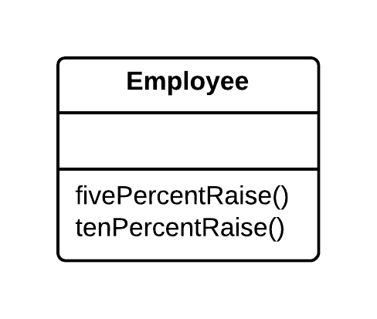
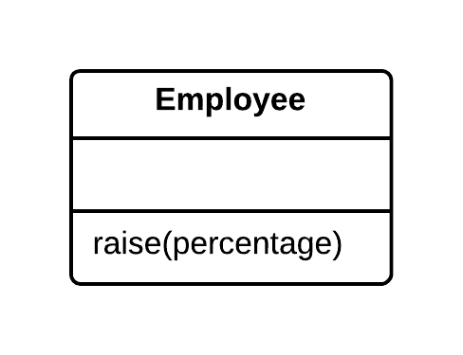
Parameterize Method
Problem | Solution
Multiple methods perform similar actions that are different only in their internal values, numbers or operations. | Combine these methods by using a parameter that will pass the necessary special value.

Slide 34
Parameterize Method
Why Refactor
If you have similar methods, you probably have duplicate code, with all the consequences that this entails.
What’s more, if you need to add yet another version of this functionality, you will have to create yet another method. Instead, you could simply run the existing method with a different parameter.

Slide 35
Parameterize Method
Drawbacks
Sometimes this refactoring technique can be taken too far, resulting in a long and complicated common method instead of multiple simpler ones.
Also be careful when moving activation/deactivation of functionality to a parameter. This can eventually lead to creation of a large conditional operator that will need to be treated via Replace Parameter with Explicit Methods.

Slide 36
Parameterize Method
How to Refactor
Create a new method with a parameter and move it to the code that is the same for all classes, by applying Extract Method. Note that sometimes only a certain part of methods is the same. In this case, refactoring consists of extracting only the same part to a new method.
In the code of the new method, replace the special/differing value with a parameter.
For each old method, find the places where it is called, replacing these calls with calls to the new method that include a parameter. Then delete the old method.

Slide 37
Doug Lea gave me a warning about refactoring's that reduce parameter lists. Concurrent programming often uses long parameter lists. Typically, this occurs so that you can pass in immutable parameters, as built-ins and value objects often are. Usually, you can replace long parameter lists with immutable objects, but otherwise, you need to be cautious about this group of refactoring's.
One of the most valuable conventions I've used over the years is to clearly separate methods that change state (modifiers) from those that query state (queries). I don't know how many times I've got myself into trouble, or seen others get into trouble, by mixing these up. So, whenever I see them combined, I use Separate Query from Modifier to to get rid of them.

Slide 38
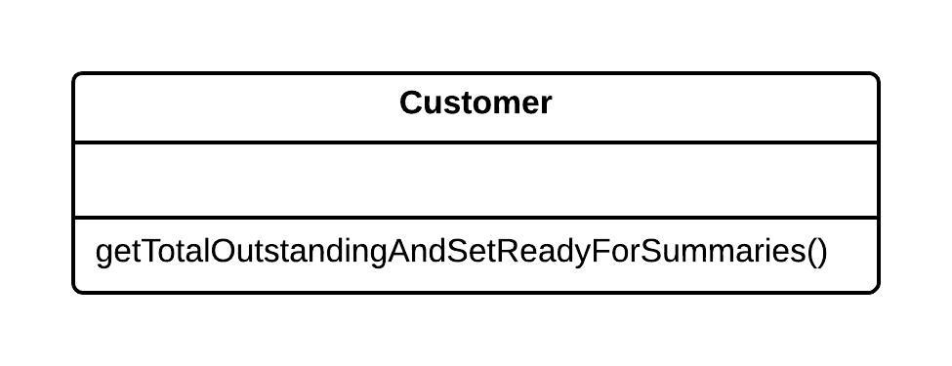
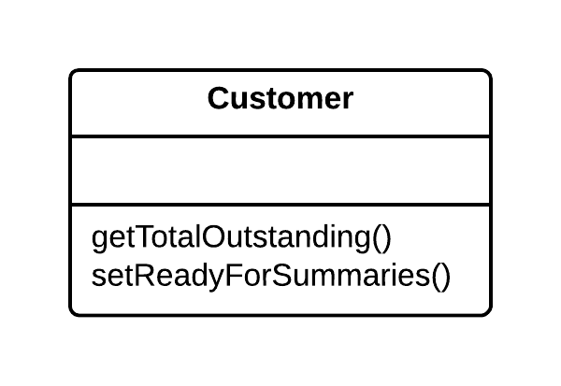
Separate Query from Modifier
Problem | Solution
Do you have a method that returns a value but also changes something inside an object? | Split the method into two separate methods. As you would expect, one of them should return the value and the other one modifies the object.

Slide 39
Separate Query from Modifier
Why Refactor
This factoring technique implements Command and Query Responsibility Segregation. This principle tells us to separate code responsible for getting data from code that changes something inside an object.
Code for getting data is named a query. Code for changing things in the visible state of an object is named a modifier. When a query and modifier are combined, you do not have a way to get data without making changes to its condition. In other words, you ask a question and can change the answer even as it is being received. This problem becomes even more severe when the person calling the query may not know about the method’s “side effects”, which often leads to runtime errors.
But remember that side effects are dangerous only in the case of modifiers that change the visible state of an object. These could be, for example, fields accessible from an object’s public interface, entry in a database, in files, etc. If a modifier only caches a complex operation and saves it within the private field of a class, it can hardly cause any side effects.

Slide 40
Separate Query from Modifier
Benefits
If you have a query that does not change the state of your program, you can call it as many times as you like without having to worry about unintended changes in the result caused by the mere fact of you calling the method.
Drawbacks
In some cases, it is convenient to get data after performing a command. For example, when deleting something from a database you want to know how many rows were deleted.

Slide 41
Separate Query from Modifier
How to Refactor
Create a new query method to return what the original method did.
Change the original method so that it returns only the result of calling the new query method.
Replace all references to the original method with a call to the query method. Immediately before this line, place a call to the modifier method. This will save you from side effects in case if the original method was used in a condition of a conditional operator or loop.
Get rid of the value-returning code in the original method, which now has become a proper modifier method.

Slide 42
Good interfaces show only what they must and no more. You can improve an interface by hiding things. Of course, all data should be hidden (I hope I don't need to tell you to do that), but also any methods that can should be hidden. When refactoring you often need to make things visible for a while and then cover them up with Hide Method and Remove Setting Method.

Slide 43
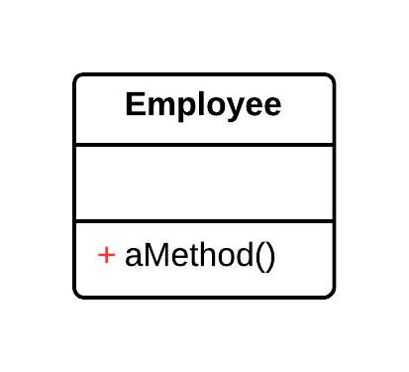
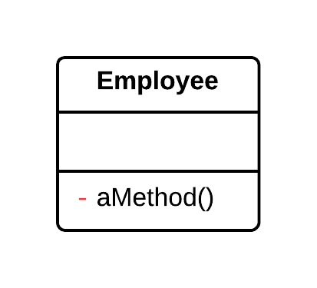
Hide Method
Problem | Solution
A method is not used by other classes or is used only inside its own class hierarchy. | Make the method private or protected.

Slide 44
Hide Method
Why Refactor
Quite often, the need to hide methods for getting and setting values is due to development of a richer interface that provides additional behavior, especially if you started with a class that added little beyond mere data encapsulation.
As new behavior is built into the class, you may find that public getter and setter methods are no longer necessary and can be hidden. If you make getter or setter methods private and apply direct access to variables, you can delete the method.

Slide 45
Hide Method
Benefits
Hiding methods makes it easier for your code to evolve. When you change a private method, you only need to worry about how to not break the current class since you know that the method cannot be used anywhere else.
By making methods private, you underscore the importance of the public interface of the class and of the methods that remain public.

Slide 46
Hide Method
How to Refactor
Regularly try to find methods that can be made private. Static code analysis and good unit test coverage can offer a big leg up.
Make each method as private as possible.

Slide 47
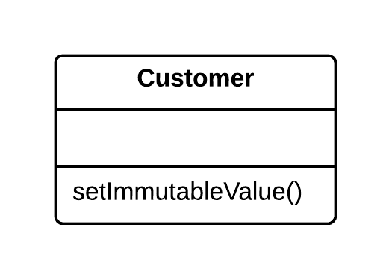
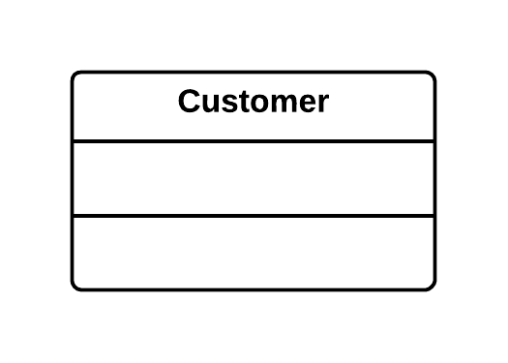
Remove Setting Method
Problem | Solution
The value of a field should be set only when it is created, and not change at any time after that. | So, remove methods that set the field’s value.

Slide 48
Remove Setting Method
Why Refactor
You want to prevent any changes to the value of a field.

Slide 49
Remove Setting Method
How to Refactor
The value of a field should be changeable only in the constructor. If the constructor does not contain a parameter for setting the value, add one.
Find all setter calls.
If a setter call is located right after a call for the constructor of the current class, move its argument to the constructor call and remove the setter.
Replace setter calls in the constructor with direct access to the field.

Slide 50
Constructors are a particularly awkward feature of Java and C++
because they force you to know the class of an object you need to create. Often you don't need to know this. The need to know can be removed with Replace Constructor with Factory Method.

Slide 51
Replace Constructor with Factory Method
Problem | Solution
You have a complex constructor that does something more than just setting parameter values in object fields. | Create a factory method and use it to replace constructor calls.
class Employee {
Employee(int type) {
this.type = type;
}
// ...
}
class Employee {
static Employee create(int type) {
employee = new Employee(type);
// do some heavy lifting.
return employee;
}
// ...
}

Slide 52
Replace Constructor with Factory Method
Why Refactor
The most obvious reason for using this refactoring technique is related to Replace Type Code with Subclasses.
You have code in which an object was previously created, and the value of the coded type was passed to it. After use of the refactoring method, several subclasses have appeared and from them you need to create objects depending on the value of the coded type. Changing the original constructor to make it return subclass objects is impossible, so instead we create a static factory method that will return objects of the necessary classes, after which it replaces all calls to the original constructor.
Factory methods can be used in other situations as well, when constructors aren’t up to the task. They can be important when attempting to Change Value to Reference. They can also be used to set various creation modes that go beyond the number and types of parameters.

Slide 53
Replace Constructor with Factory Method
Benefits
A factory method does not necessarily return an object of the class in which it was called. Often these could be its subclasses, selected based on the arguments given to the method.
A factory method can have a better name that describes what and how it returns what it does, for example Troops::GetCrew(myTank).
A factory method can return an already created object, unlike a constructor, which always creates a new instance.

Slide 54
Replace Constructor with Factory Method
How to Refactor
Create a factory method. Place a call to the current constructor in it.
Replace all constructor calls with calls to the factory method.
Declare the constructor private.
Investigate the constructor code and try to isolate the code not directly related to constructing an object of the current class, moving such code to the factory method

Slide 55
Casting is another bane of the Java programmer's life. As much as possible try to avoid making the user of a class do down casting if you can contain it elsewhere by using Encapsulate Downcast.

Slide 56
Encapsulate Downcast
Problem | Solution
Object lastReading() {
return readings.lastElement();
}
Reading lastReading() {
return (Reading) readings.lastElement();
}

Slide 57
Java, like many modern languages, has an exception-handling mechanism to make error handling easier. Programmers who are not used to this often use error codes to signal trouble. You can use Replace Error Code with Exception to use the new exceptional features. But sometimes exceptions aren't the right answer; you should test first with Replace Exception with Test .

Slide 58
Replace Error Code with Exception
Problem | Solution
A method returns a special value that indicates an error? | Throw an exception instead.
int withdraw(int amount) {
if (amount > _balance) {
return -1;
}
else {
balance -= amount;
return 0;
}
}
void withdraw(int amount) throws BalanceException {
if (amount > _balance) {
throw new BalanceException();
}
balance -= amount;
}

Slide 59
Replace Error Code with Exception
Why Refactor
Returning error codes is an obsolete holdover from procedural programming. In modern programming, error handling is performed by special classes, which are named exceptions. If a problem occurs, you “throw” an error, which is then “caught” by one of the exception handlers. Special error-handling code, which is ignored in normal conditions, is activated to respond.

Slide 60
Replace Error Code with Exception
Benefits
Frees code from many conditionals for checking various error codes. Exception handlers are a much more succinct way to differentiate normal execution paths from abnormal ones.
Exception classes can implement their own methods, thus containing part of the error handling functionality (such as for sending error messages).
Unlike exceptions, error codes cannot be used in a constructor, since a constructor must return only a new object.
Drawbacks
An exception handler can turn into a goto-like crutch. Avoid this! Do not use exceptions to manage code execution. Exceptions should be thrown only to inform of an error or critical situation.

Slide 61
Replace Error Code with Exception
How to Refactor
Try to perform these refactoring steps for only one error code at a time. This will make it easier to keep all the important information in your head and avoid errors.
Find all calls to a method that returns error codes and, instead of checking for an error code, wrap it in try/catch blocks.
Inside the method, instead of returning an error code, throw an exception.
Change the method signature so that it contains information about the exception being thrown (@throws section).

Slide 62
Replace Exception with Test
Problem | Solution
You throw an exception in a place where a simple test would do the job? | Replace the exception with a condition test.
double getValueForPeriod(int periodNumber) { try {
return values[periodNumber]; }
catch (ArrayIndexOutOfBoundsException e) {
return 0;
}
}
double getValueForPeriod(int periodNumber) {
if (periodNumber >= values.length) {
return 0;
}
return values[periodNumber];
}

Slide 63
Replace Exception with Test
Why Refactor
Exceptions should be used to handle irregular behavior related to an unexpected error. They should not serve as a replacement for testing. If an exception can be avoided by simply verifying a condition before running, then do so. Exceptions should be reserved for real errors.
For instance, you entered a minefield and triggered a mine there, resulting in an exception; the exception was successfully handled, and you were lifted through the air to safety beyond the mine field. But you could have avoided this all by simply reading the warning sign in front of the minefield to begin with.

Slide 64
Replace Exception with Test
Benefits
A simple conditional can sometimes be more obvious than exception handling code

Slide 65
Replace Exception with Test
How to Refactor
Create a conditional for an edge case and move it before the try/catch block.
Move code from the catch section inside this conditional.
In the catch section, place the code for throwing a usual unnamed exception and run all the tests.
If no exceptions were thrown during the tests, get rid of the try/catch operator.

